Slide 1
Literacy is at the Heart of Coding Playgrounds for Young Learners Dr. Peggy S. Lisenbee, Assistant Professor of Early Childhood Dev & Education
Download ScratchJr and Lego WeDo on your tablet.
IF you only have a computer, find these websites to view information, but you won’t be able to interact with ScratchJr (but you interact on Scratch).

Slide 2
Technology is…

Slide 3
Playgrounds offer…

Slide 4
Vocabulary –definitions…
Bug
Unplugged
Algorithm
Fail

Slide 5
STEM/ STEAM/ STREAM
Science
Technology
Engineering
Mathematics
Arts
Research or wRiting

Slide 6
Literacy—Vocabulary
Bug - Something that is going wrong. An error.
Debugging - To find and fix errors.
Persistence - Not giving up. Persistence works best when you try things many different ways, many different times.
Unplugged Coding Activities - An activity that can be conducted without the use of computers or electronic equipment. Many of the activities simply require pencil, paper and problem solving.
Persistence - Not giving up. Persistence works best when you try things many different ways, many different times.
Frustrated - Feeling annoyed or angry because something is not the way you want it.
F.A.I.L. - First Attempt in learning. When you try to do something, but you don't do it quite right.
Algorithm - A list of steps that you can follow to finish a task.

Slide 7
Makerspaces/ Hackerspaces
Unstructured open areas for exploration and learning as dictated by each individuals’ interest
Community spaces for collaborative learning and tinkering with technology

Slide 8
Coding Playgrounds explore, make, experiment, create, and “fail-forward” (Krakower & Martin, 2019, p. 19)
Classroom (seating, power, storage, displays, & students)
STEAM boxes (like prop boxes)/ Makerspaces
Coding activities (unplugged & beginning coding)

Slide 9
Coding Playgrounds: Unplugged
STEAM Boxes
Makerspaces
Code.org--Unplugged Lessons
ScratchJr Blocks
Human Programming

Slide 10
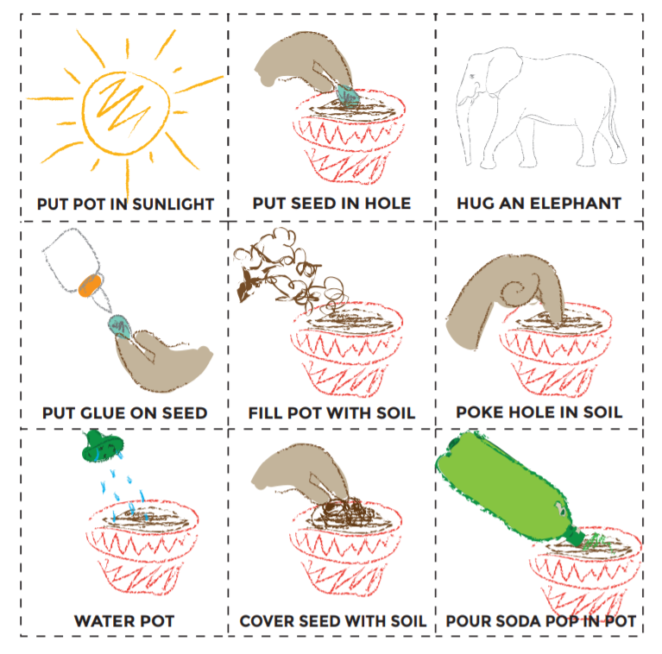

Slide 11
6
3
1
2
5
4

Slide 12
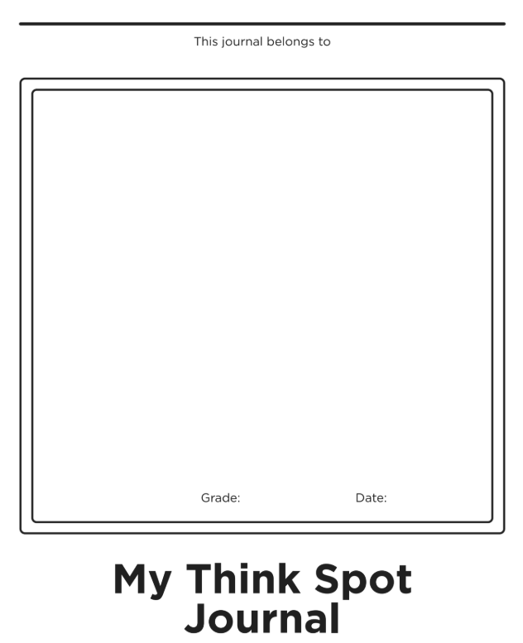

Slide 15
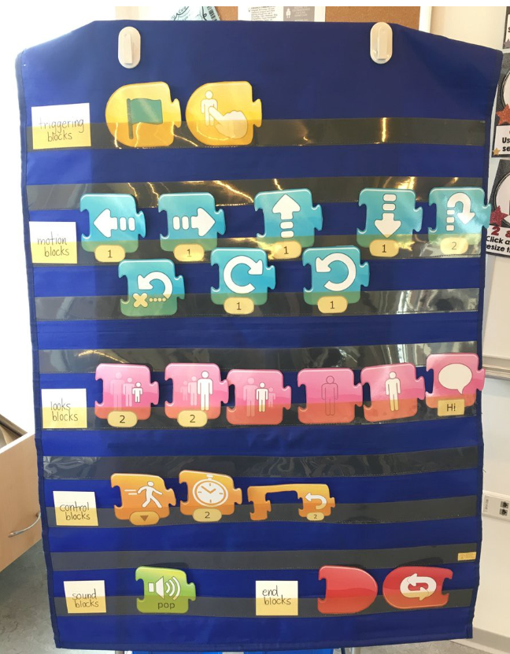
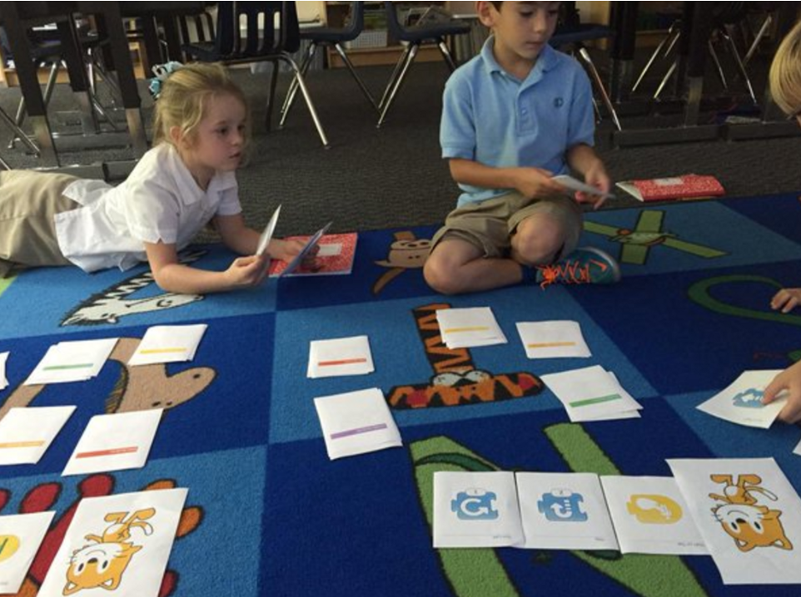

Slide 16
Literacy—Reading to follow directions (Human Programming)
Clear directions are essential
Step right two steps; Hop three times; One step forward; Hop two times; One step backwards; Take two steps to the left

Slide 17
Coding Playgrounds: Beginning Graphical Coding
Code.org
Hour of Code
Hopscotch App
ScratchJr

Slide 18
ScratchJr Demo

Slide 19
ScratchJr “Vocabulary”

Slide 20
ScratchJr
Let’s try this activity together
—Drive Across Town

Slide 22
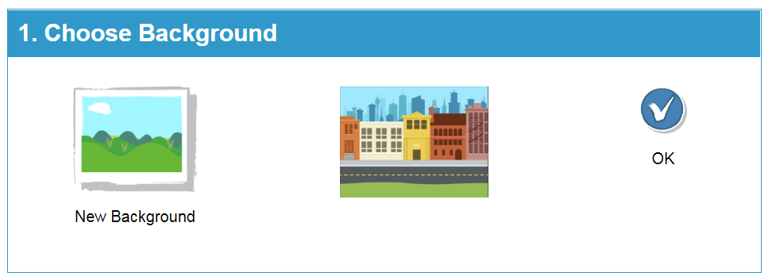

Slide 23
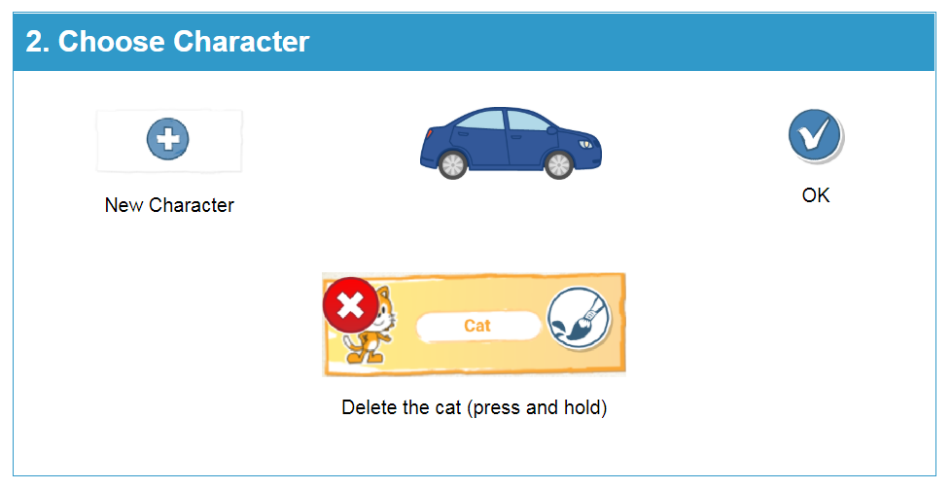

Slide 27
Coding Playgrounds: Tangible Coding with Robots
Lego WeDo 2.0 kits

Slide 28
Let me show you the Coding Playground I created for you today!

Slide 29
Coding Playground #1 STEAM Box: Marshmallow Challenge

Slide 30
Coding Playground #2 ScratchJr: Any practice coding activities 2-9
https://www.scratchjr.org/teach/activities
For use on tablets only

Slide 31
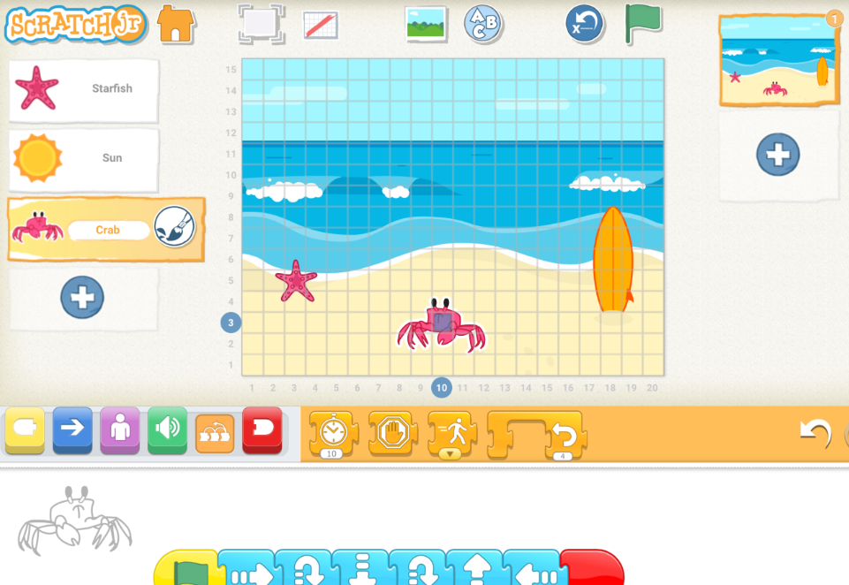
Coding Playground #3 ScratchJr: Create Your Own

Slide 32
Coding Playground #4 Scratch: Create Your Own

Slide 33
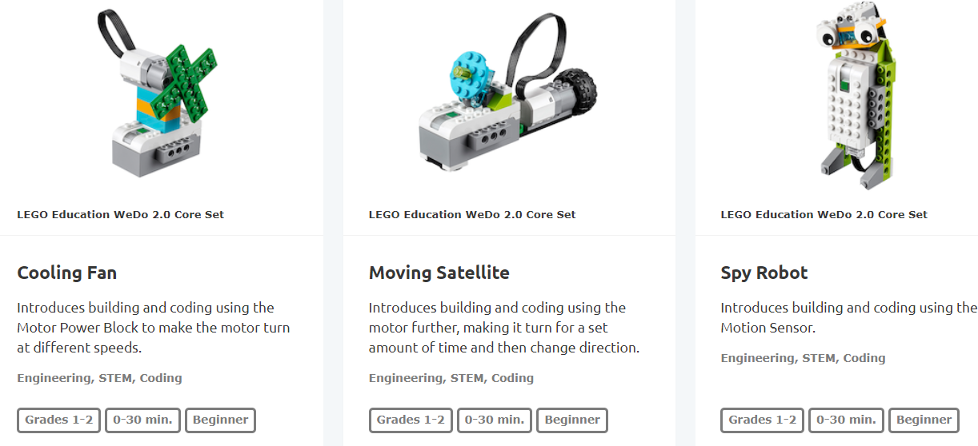
Coding Playground #5 Lego WeDo 2.0, grades 1-2 Cooling Fan, Moving Satellite, or Spy Robot

Slide 34
Coding Playground #6 Lego WeDo 2.0, grades 3-5 Glowing Snail

Slide 35
Extra Coding Playground Code.org/ Hourofcode.com / Hopscotch app

Slide 36
IF YOU GET DONE WITH THE CODING PLAYGROUND BEFORE OTHERS…
Go to hourofcode.com and try your hand at creating some code…
Go to code.org to look at the curriculum lessons and see which one you want to start with in your classroom.
Download the Hopscotch app to practice coding on your phone or tablet.

Slide 37
Resources
Instructables.com/teachers/
Pbskids.org/designsquad/parentseducators/
Makerspaces.com
Extraordinaires.com
dschool.stanford.edu/resources
Pinterest (STEAM, Makered, etc.)
Twitter (@STEM, @STEAM, etc )
Makerpromise.org
Raspberrypi.org
Makered.org
Code.org and Hourofcode.com
sparkfuneducation.com
Littlebits.com
Sphero.com
Chibitronics.com
Makeymakey.com
Microbit.org
Finchrobot.com
education.lego.com

Slide 38
REFERENCES:
Bers, M.U. (2018). Coding as a playground: Programming and computational thinking in the early childhood classroom. New York, NY: Routledge. ISBN-13: 978-1138225626
Krakower, B. & Martin, M. (2019). Getting started with STEAM: Practical strategies for the k-8 classroom. New York, NY: Routledge. ISBN-13: 978-1138586635

Slide 39
CODING SITE REFERENCES
Code.com
Hourofcode.com
Education.lego.com/en-us/lessons
ScratchJr.org (creation component available on tablets only)
ScratchJr Illustrations of Moving Blocks:
www.scratchjr.org/pdfs/blocks.pdf
Scratch.mit.edu

Slide 40
Thank you for attending, I would love some constructive feedback at this Doodle poll: text to 37607, then type in peggylisenbee260 in the message to join my poll then share your comments about the workshop. Thanks!
For today’s PP, go to Presentations on my website,
https://plisenbee.wixsite.com/website
Interested in completing an ONLINE masters degree in two years with courses in STEAM, brain-based learning, policy & advocacy, community partnerships culminating in a teacher action research project in your classroom?
Contact ssnider@twu.edu about a summer
camp opportunity in the month of June.

Slide 41
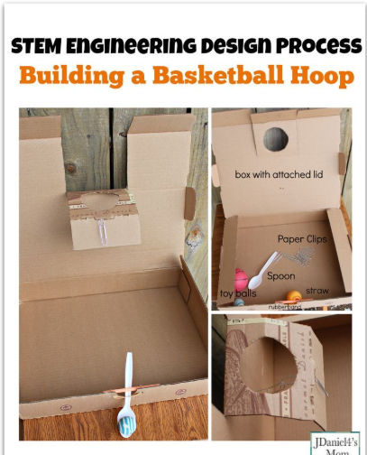
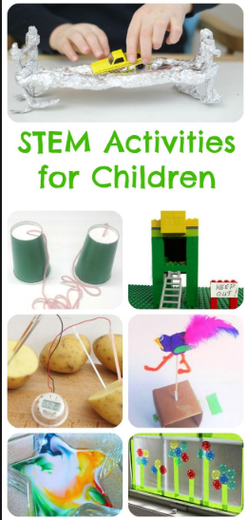
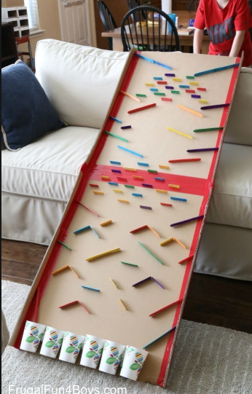

Slide 42
CODING PLAYGROUND TABLE SIGNS

Slide 43
Coding Playground #1 STEAM Box: Marshmallow Challenge Unplugged Activity

Slide 44
Coding Playground #1 STEAM Box: Marshmallow Challenge Unplugged Activity
The goal is to create marshmallow tower that is at least 12” in height that doesn’t fall over (ever).

Slide 45
Coding Playground #2 ScratchJr: Any practice coding activities 2-9
https://www.scratchjr.org/teach/activities
For use on tablets only

Slide 46
Coding Playground #3 ScratchJr: Create Your Own

Slide 47
Coding Playground #4 Scratch: Create Your Own Tutorials at: https://scratch.mit.edu/projects/290354270/editor

Slide 48
Coding Playground #5 Lego WeDo 2.0, grades 1-2 Cooling Fan, Moving Satellite, or Spy Robot

Slide 49
Coding Playground #5 Lego WeDo 2.0, grades 1-2 Cooling Fan, Moving Satellite, & Spy Robot
Click on Lego Education app
X out of the review screen if it pops up
Otherwise, click on Classroom Projects
Choose one of the three activities above and follow the directions—have fun!!
Then shout NEXT so someone else can try.

Slide 50
Coding Playground #6 Lego WeDo 2.0, grades 3-5 Glowing Snail

Slide 51
Coding Playground #6 Lego WeDo 2.0, grades 3-5 Glowing Snail
Click on Lego Education app
X out of the review screen if it pops up
Otherwise, click on Classroom Projects
Choose the glowing snail activity and follow the directions—have fun!!
Then shout NEXT so someone else can try.

Slide 52
Coding Playground EXTRA TIME ACTIVITIES Hourofcode.com / Hopscotch app

