Slide 1
STARS@Night
2016 Judy Richardson Literacy as a Living Legacy Award
Family Involvement Literacy Program
Presented by Dr. Peggy S. Lisenbee, plisenbee@twu.edu Texas Woman’s University

Slide 2
IN 2016, THIS FAMILY LITERACY PROGRAM won ALER's Judy Richardson Literacy as a Living Legacy Award
The objectives of the STARS @ NIGHT family literacy program were to:
Engage parents in supporting their child’s practice of reading skills using iRead.
Increase struggling readers’ reading skills.
Expose parents to English reading skills surreptitiously as they support their child’s practice of reading skills.

Slide 3
Family involvement research
Research recommends putting forth an effort to engage families with students as they learn since these programs and interventions “are linked to higher student achievement” (Henderson & Mapp, 2002, p. 25).
Research has found that students are interested in having their families actively engaged in their education and knowledgeable about their educational needs. This type of support is found to make students more successful in school (Epstein, 2010).

Slide 4
Research on family involvement and literacy skill improvement
Early literacy research encourages programs to include at-home support for families of beginning readers since there are “statistically significant and moderate to large effects on children’s oral language skills and general cognitive abilities” (NELP, 2008, p. ix).
Marilyn Adams (1990) noted that “[T]he most important activity for building the knowledge and skills eventually required for reading is . . . reading aloud to children,” thereby “engaging them regularly and interactively in the enjoyment and exploration of print” (pp. 86, 411).
Scholastic Kids & Family Reading Report (2013) found that 65% of parents read to their Kindergarten to 2nd-grade children once a week while the other 35% of families don’t read to their children (Harrison Group).
Research recommends that teachers provide at-home reading assignments, supplementary reading lists, and parent education to support literacy skills in students (Adams, 1990; Epstein, 2010; NRC, 1998).

Slide 5
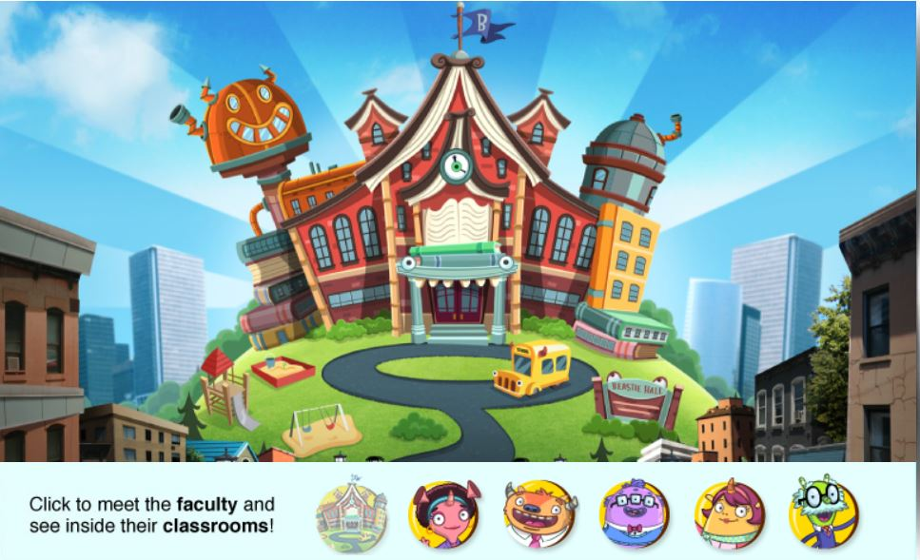
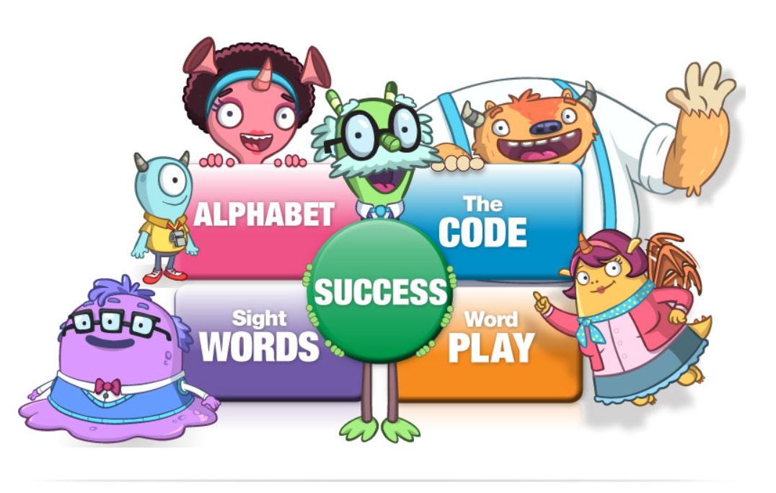
Iread
Scholastic created this computer literacy program for pre-kindergarten to second grade students to practice all five essential components of reading (phonemic awareness, phonics, vocabulary, fluency and comprehension) in an engaging, interactive, and game-like learning environment.
IRead is a computer assisted instruction (CAI) literacy program providing differentiated reading instruction for each child based on formative and summative assessments embedded in the reading program.

Slide 6
Purpose of research
The STARS @ Night program was created to engage parents with their child as they used iRead to practice their reading skills and to see if students improved their reading skills.
STARS @ Night was offered once a month at the elementary school in one of their computer labs where the STARS students attend school.
Two other similar IRead programs:
IRead is a computer literacy program required for Pre-Kindergarten, 1st Grade, and 2nd Grade students, in a Midwestern school district, to engage in for 20 minutes every day during the school year.
During summer 2015 and 2016, students participated in STARS using iRead during their summer camps sponsored by the school district.

Slide 7
Sample of students
Previous STARS students were invited to participate with their parents in the STARS @ Night program:
There were six participants.
One Kindergarten student, three first-grade and two second-grade students.
Four participants attended with a parent (three Moms and one Dad).
The students were female and male, three of each gender.
The racial make-up of the four parent-child dyads participating were two Caucasian and two Hispanic dyads.
The Caucasian parents and children spoke and understood English.
The Hispanic parents did not speak English but could understand English while their children both spoke and understood English.

Slide 8
Research methods
The family literacy program was offered to pre-kindergarten to second-grade students attending an after-school program using observation and structured interviews.
Post-interviews were conducted with both the parents and students participating in this family literacy program.
Students' progress in reading skills was monitored to provide data about improvement of reading skills while including parental support using the schools’ existing computer assisted instruction reading program, Scholastic’s IREAD.

Slide 9
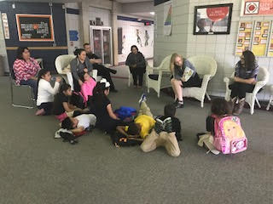
methodology
The STARS @ Night program began with a read aloud to the families during each monthly program using board books and easy readers.
A discussion of the vocabulary in each book was conducted following each read aloud to encourage and allow families to write words in their native language below the English words in the books to help them remember the English translations.

Slide 10
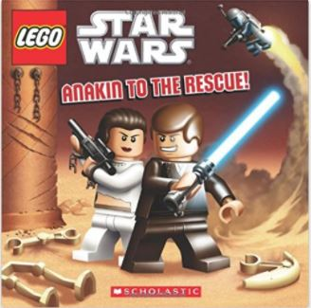
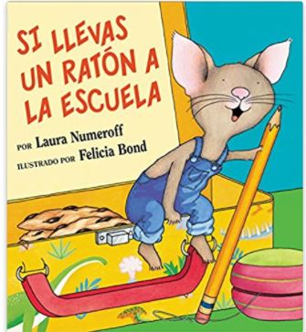
BOOKS GIVEN TO FAMILIES DURING FIVE MONTHS

Slide 11
Methodology continued…
After the read aloud and discussion of vocabulary, students led their parents to the computer lab to begin their 20 minutes on iRead using the headphone splitters.
The STARS @ Night program offered parents an opportunity to observe their child engage with iRead through the use of a headphone splitter attached to one headphone jack on the computer making it possible for two headphones to:
hear the iRead directions and their child’s answers as they practiced reading skills
helped parents understand their child’s progress (or lack thereof).

Slide 12
Parents used headphone splitters to listen and assist their child as they practiced on IRead for 20 minutes of reading skill practice.

Slide 13
Methodology continued…
One benefit of attending STARS summer programs was the option to chew gum as they practiced their reading skills on iRead so STARS @ Night students requested to chew gum during this program also.
At the end of the 20 minutes, the students checked their progress on iRead and recorded their progress on the graph.
The books read during the initial Read Aloud were taken home with the STARS @ Night families after each session for continued reading practice.

Slide 18
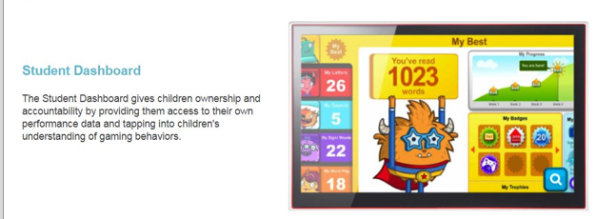
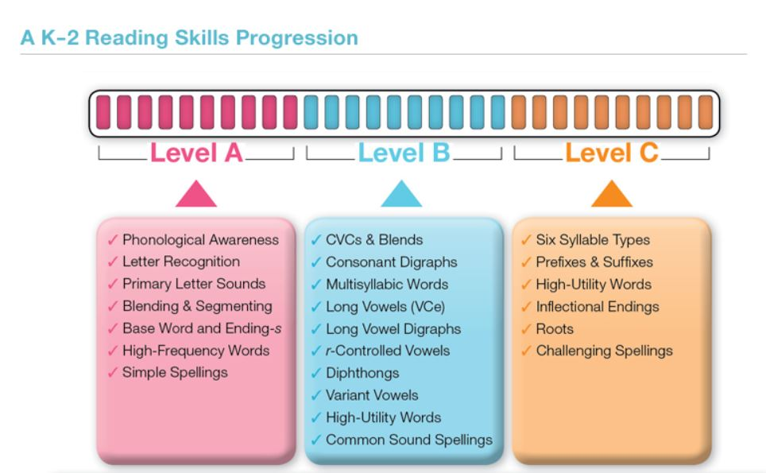
Student dashboard reading skills progression

Slide 19
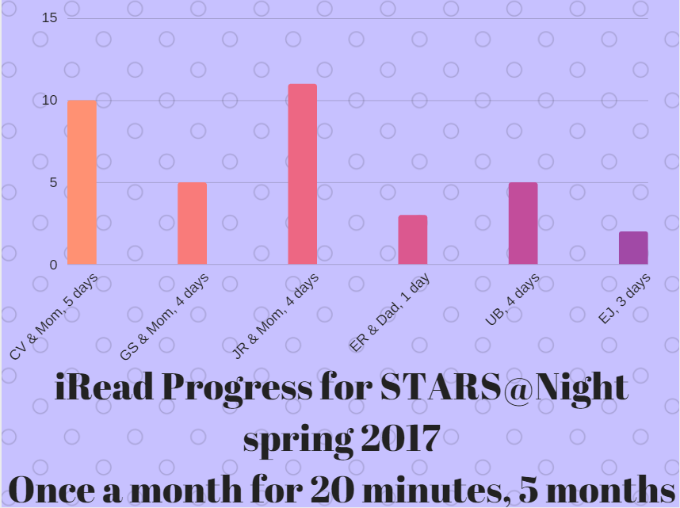
Students increase in reading skills ranged from an increase of three iRead topics
after attending one day of STARS @ Night with a parent (20 minutes)
to one student increasing 11 topics in iRead after attending five days with a parent (100 minutes).
K
1
1
1
2
2

Slide 20
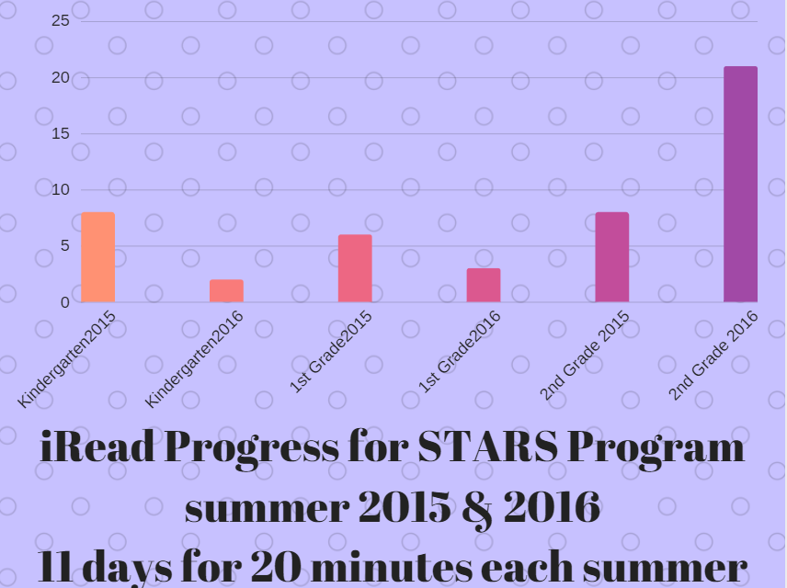

Slide 21
Survey results from parents
The results of implementing the STARS @ Night program provided both quantitative and qualitative data.
Parents responded in a post-survey checking off the items which motivated them the most to attend and engage in STARS @ Night with their students:
free books = 3
learning English = 2
supporting their child = 1
to increase their child’s confidence = 4

Slide 23
Survey results from students
Students responded in a post-interview/survey where an undergraduate student checked off the items they reported to the interviewer that motivated them the most to attend and engage in STARS @ Night with their parents:
free books = 3
parents possibly learning English = 2
parent forced them to participate = 4
parent attending with them to practice iRead = 2
friend attending with them = 1
increasing their skills and confidence in reading = 4

Slide 24
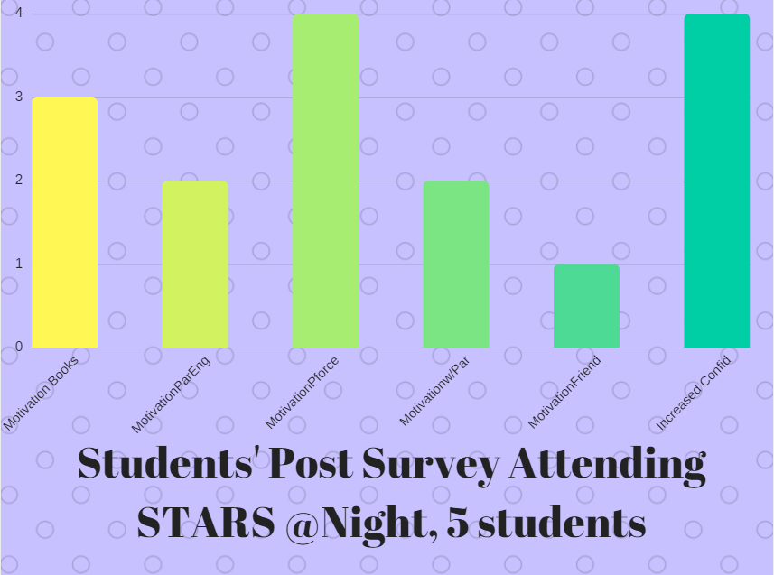

Slide 25
Comments from Parents’ post participation interviews and students’ post participation interviews
An undergraduate student fluent in English and Spanish interviewed all the parents and children after the four days was over providing these comments when asked about their own confidence following participation in this program.

Slide 26
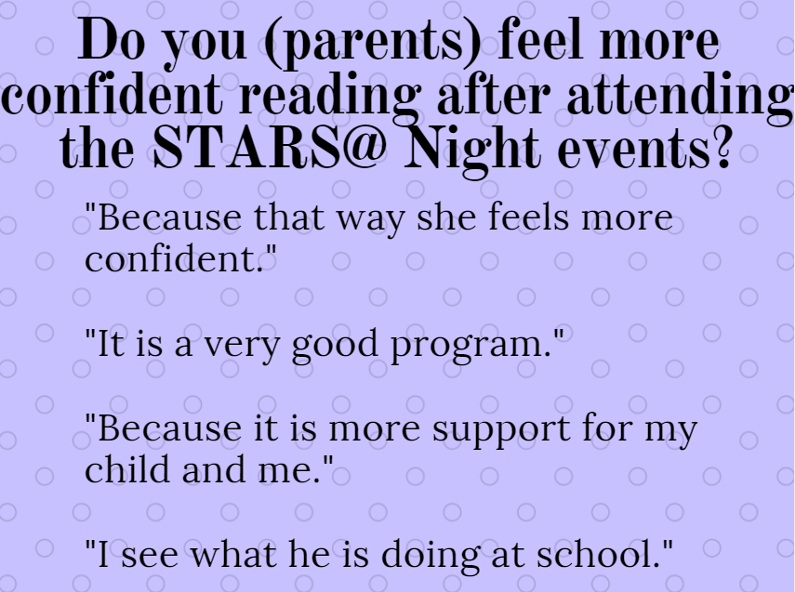

Slide 27
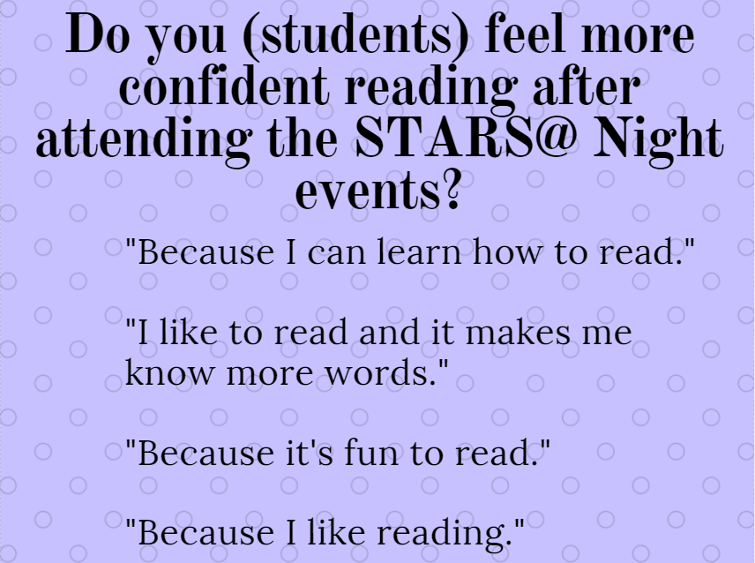

Slide 28
implications
The results support research about the effectiveness of parental support for students struggling to read. Baker (2010) found that a supportive home environment supported improvement in reading skills and reading comprehension was enhanced for struggling readers when school and home collaborated on reading interventions.
There needs to be more research with larger populations since research was only on four families; yet, it demonstrated some positive results. This program can be easily replicated in any after-school program or family support organization.
Another side benefit of offering STARS @ Night was the parents’ exposure to literacy skills allowing them an opportunity to learn how to learn to read which:
might help parents learn to read indirectly instead of participating in a separate formal literacy program for adults.
demonstrate how parents can access iRead from any computer whether at school, at home, or at a library.

Slide 30
RE F ERENCE S
Adams, M. J. (1990). Beginning to read: Thinking and learning about print. Cambridge, MA: MIT Press.
Baker, L. (2010). The role of parents in motivating struggling readers. Reading & Writing Quarterly, 19(1), 87-106.
Epstein, J. L. (2010). School, family, and community partnerships: Preparing educators and improving schools (2nd ed.). Boulder, CO
Harrison Group. (2013). Kids and family reading report (4th ed.). New York, NY: Scholastic, Inc. Retrieved January 16, 2013, from http:// mediaroom.scholastic.com/files/kfrr2013-wappendix.pdf
National Early Literacy Panel (NELP). (2008). Developing early literacy: Report of the National Early Literacy Panel. Washington, DC: National Institute for Literacy, National Center for Family Literacy.
National Research Council (NRC). (1998). Preventing reading difficulties in young children. C. E. Snow, M. S. Burns, & P. Griffin (Eds.). Washington, DC: National Academies Press.
Westview Press. Henderson, A. & Mapp. K. (2002). A new wave of evidence: The impact of school, family, and community connections on student achievement. Austin, TX: Southwest Education Development Laboratory

